Slide 1
ROLEREADY
Presented by
Sk.Sabiha
Sd.Shabnam
Md.Sana

Slide 2
Introduction of the project
RoleReady is a full-stack web application designed to help students prepare for their desired job roles by identifying skill gaps and tracking their learning progress.
It allows students to select a target job role, update their existing skills, identify missing skills required for that role, and monitor their preparation through a personalized learning checklist and dashboard.
The main aim of RoleReady is to make placement preparation more structured, organized, and accessible by helping students understand which skills they need to develop to become job-ready.

Slide 3
Problem Statement
Many students face difficulties in identifying the technical skills required for their desired job roles.
Students often lack clarity about which skills they already possess and which skills they need to improve.
There is no proper way to compare existing skills with the requirements of a specific job role.
Students find it difficult to organize their learning activities and track their preparation progress.
Therefore, a platform is needed to identify skill gaps and help students track their journey towards becoming job-ready.

Slide 4
Objective
To provide a platform for students to prepare for their desired job roles.
To help students select a target job role and identify the skills required for it.
To allow students to add and update their existing technical skills.
To identify skill gaps by comparing existing skills with job role requirements.
To provide a personalized learning checklist to improve missing skills.
To track learning progress through an interactive dashboard.
To make placement preparation more structured,personalized and effective.

Slide 5
System Overview
Students can register and login to access the platform to manage their placement preparation.
Users can select a target job role, such as Frontend Developer, Backend Developer, or Java Developer.
Students can select and update their existing technical skills.
The system compares existing skills with predefined job role requirements to identify skill gaps.
Based on the missing skills, the system provides a learning checklist to guide students.
A dashboard displays matched skills, missing skills, and learning progress.
Student details and preparation progress are stored in a MySQL database.

Slide 6
Technologies and Tools
Technologies:
React.js – Used to develop the frontend and interactive user interface.
Node.js – Used to run the backend JavaScript environment.
Express.js – Used to create APIs and handle server-side requests.
MySQL – Used to store student details, job roles, skills, and learning progress.
HTML, CSS and JavaScript – Used for structuring, styling, and adding functionality to the web application.
Development Tools:
Visual Studio Code – Used for writing and managing project code.
Git and GitHub – Used for version control and storing project source code.
Vercel – Used for frontend deployment.

Slide 7
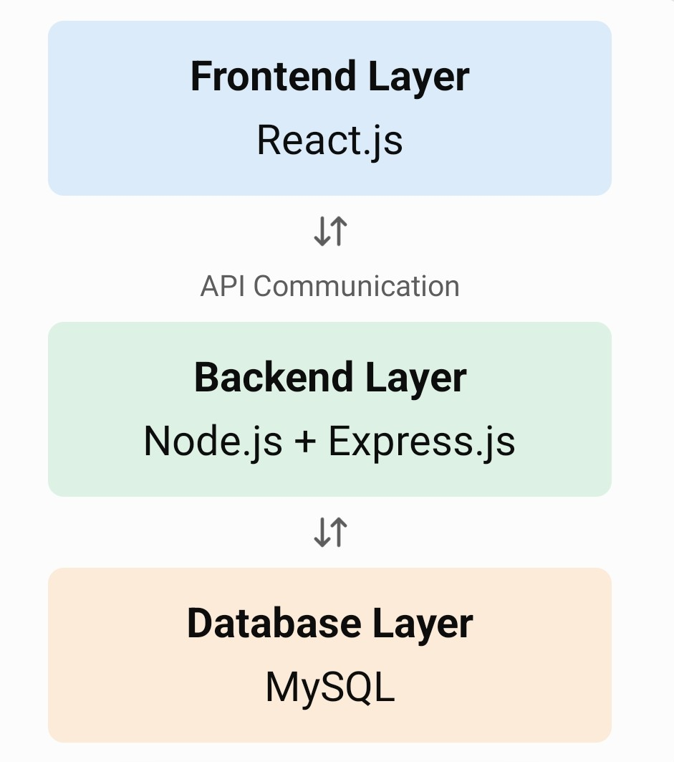
System Architecture

Slide 8
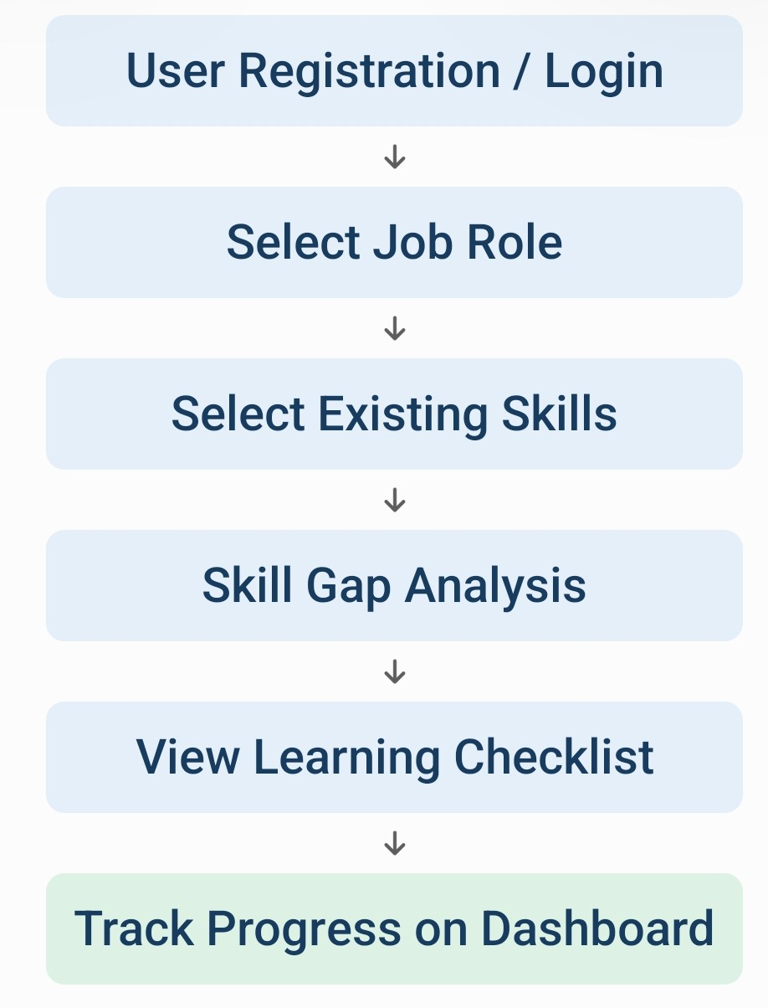
Work Flow of RoleReady

Slide 9
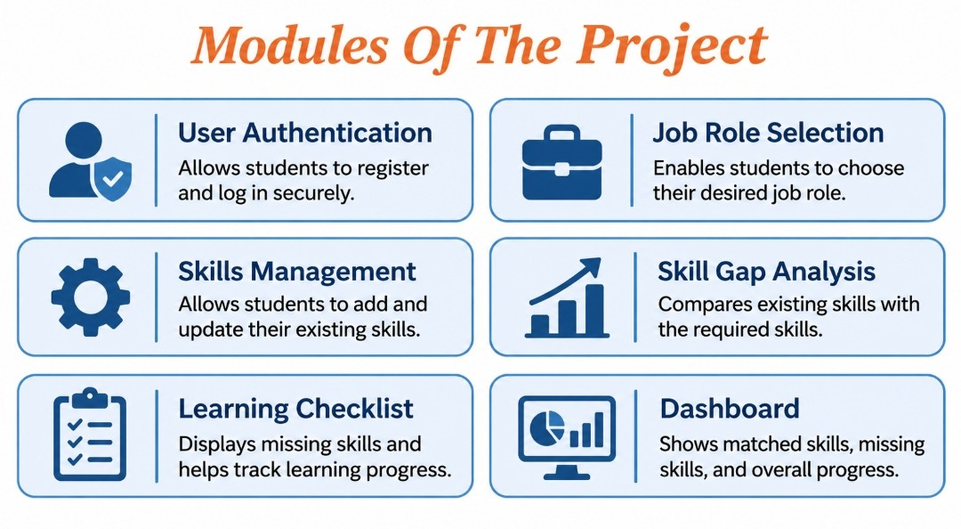

Slide 10
User Interface
Login and Registration: Allows students to create an account and access the application.
Dashboard: Displays matched skills, missing skills, and learning progress.
Job Role Selection: Allows students to choose their desired job role.
Skills Selection: Enables students to add and update their existing skills.
Skill Gap Analysis: Displays the skills that students need to improve.
Learning Checklist: Helps students monitor their learning activities.

Slide 11
Advantages
Helps students understand the skills required for their desired job roles.
Identifies missing skills by comparing existing skills with job requirements.
Provides a clear learning checklist to improve technical skills.
Helps students organize their placement preparation.
Tracks learning progress through a dashboard.
Provides a simple and user-friendly platform for job preparation

Slide 12
Challenges Faced
Designing a simple and user-friendly interface.
Connecting the React frontend with the Node.js and Express.js backend.
Managing student details and skill information in the MySQL database.
Implementing skill gap analysis by comparing existing skills with job requirements.
Maintaining accurate data flow between the frontend, backend, and database.
Testing the application and identifying errors during development.

Slide 13
Future Enhancements
Integrate AI-based personalized learning recommendations.
Add more job roles and industry-specific skill requirements.
Provide learning resources for missing skills.
Introduce resume analysis and improvement suggestions.
Add progress reports to monitor student development.
Include job and internship opportunities based on students' skills.

Slide 14


